Slide 1

Chapter 11
Personality

Slide 2
What is Personality?
Personality refers to the long-standing traits and patterns that propel individuals to consistently think, feel, and behave in specific ways
Aspects of Personality
  Long Term
  Stable
  Not easily changed

Slide 3
Historical Perspective
Concept of personality studied for at least 2,000 years
  Hippocrates: Four fluids (“humors”) 370 BCE
    choleric temperament (yellow bile from the liver)
    melancholic temperament (black bile from the kidneys)
    sanguine temperament (red blood from the heart)
    phlegmatic temperament (white phlegm from the lungs)
  Galen expanded Hippocrates’s Theory
    Suggested imbalances in the humors explain personality differences
      choleric person is passionate, ambitious, and bold
      melancholic person is reserved, anxious, and unhappy
      sanguine person is joyful, eager, and optimistic
      phlegmatic person is calm, reliable, and thoughtful

Slide 4
Contributions to Temperament Types
Immanuel Kant – Four temperaments
  No overlap between categories
  List of traits
Wilhelm Wundt – Suggested separating traits
  Two major axes
    emotional/nonemotional
    changeable/unchangeable

Slide 5
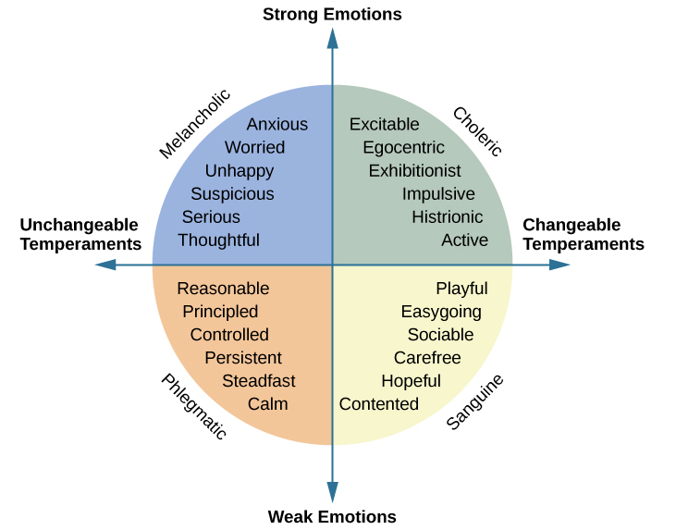

Slide 6
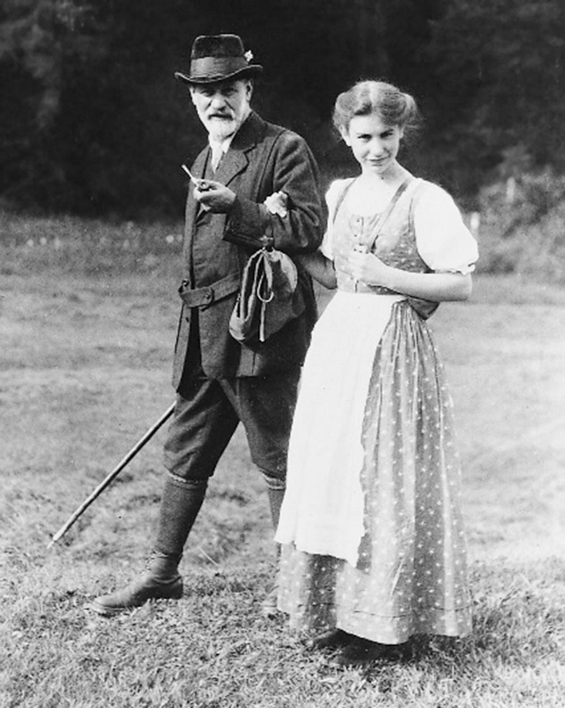
Sigmund Freud
Trained as a medical doctor in the late 1800s
Created the psychodynamic approach to personality
First to systematically study and theorize the workings of the unconscious mind

Slide 7
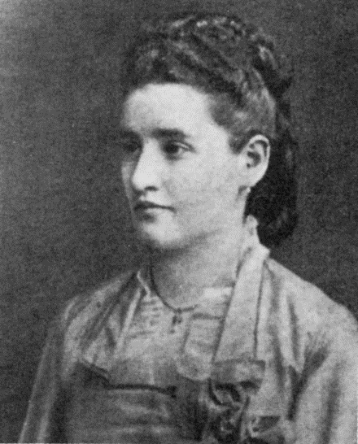
Early Career of Freud
Worked with Josef Breuer
Intrigued by Breuer’s patient
  Bertha Pappenheim (Anna O.)
  Talking relieved hysteria symptoms
Concluded hysteria was result of sexual abuse in childhood

Slide 8
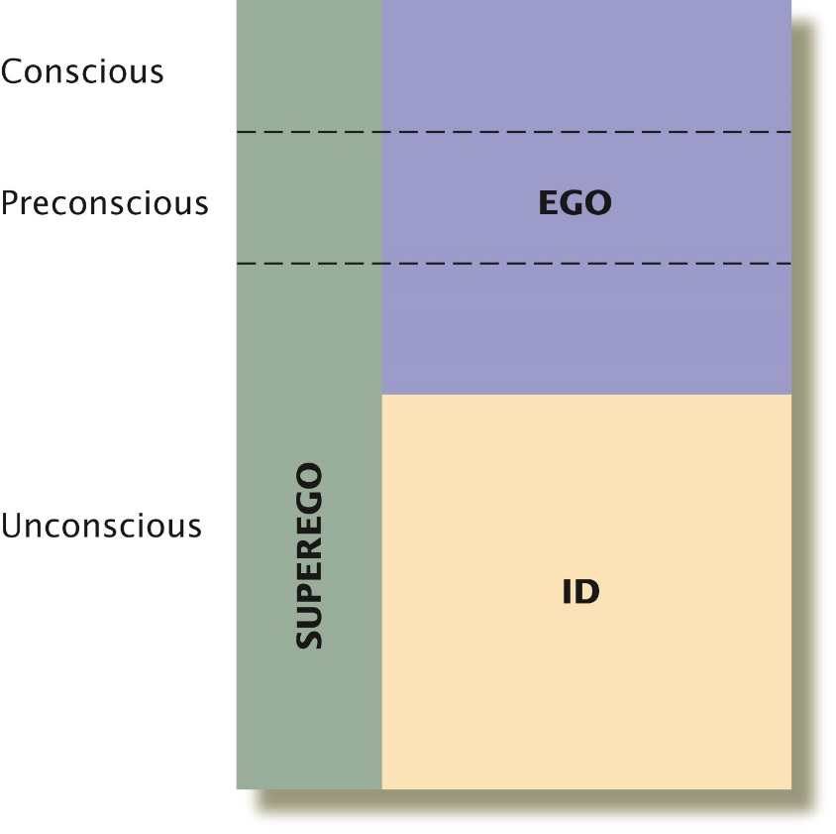
Freud’s Psychodynamic
Approach to Personality
Id
  Libido
  Pleasure principle
Ego
  Reality principle
  Guides sensible actions
  Uses defense mechanisms to prevent anxiety or guilt
Superego
  Moral imperatives
“Freudian slip”
Personality shaped by psychodynamic conflicts

Slide 9
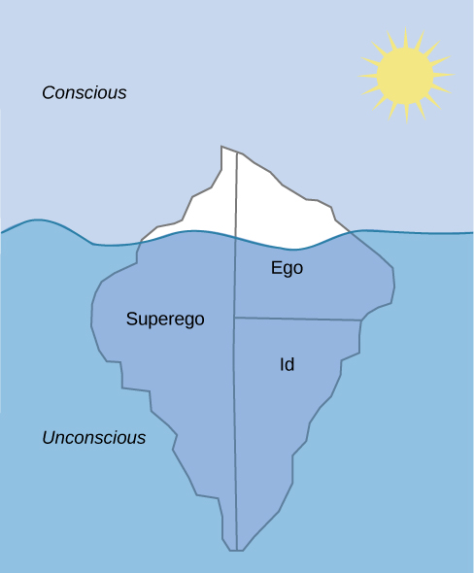

Slide 10
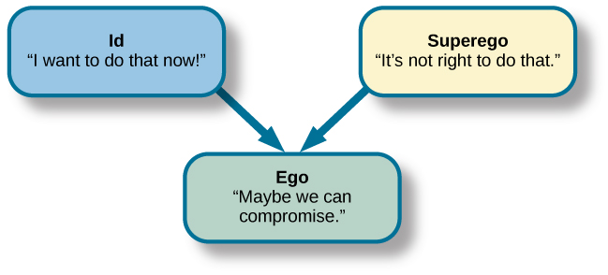
Strong ego = healthy personality
Imbalances can lead to neurosis, anxiety disorders, or unhealthy behaviors

Slide 11
Defense Mechanisms
Anxiety results from inability of ego to mediate conflict
Ego seeks to restore balance through DM
Unconscious protective behaviors aim to reduce anxiety
According to Freud we all use DM
  Overuse can be problematic

Slide 12
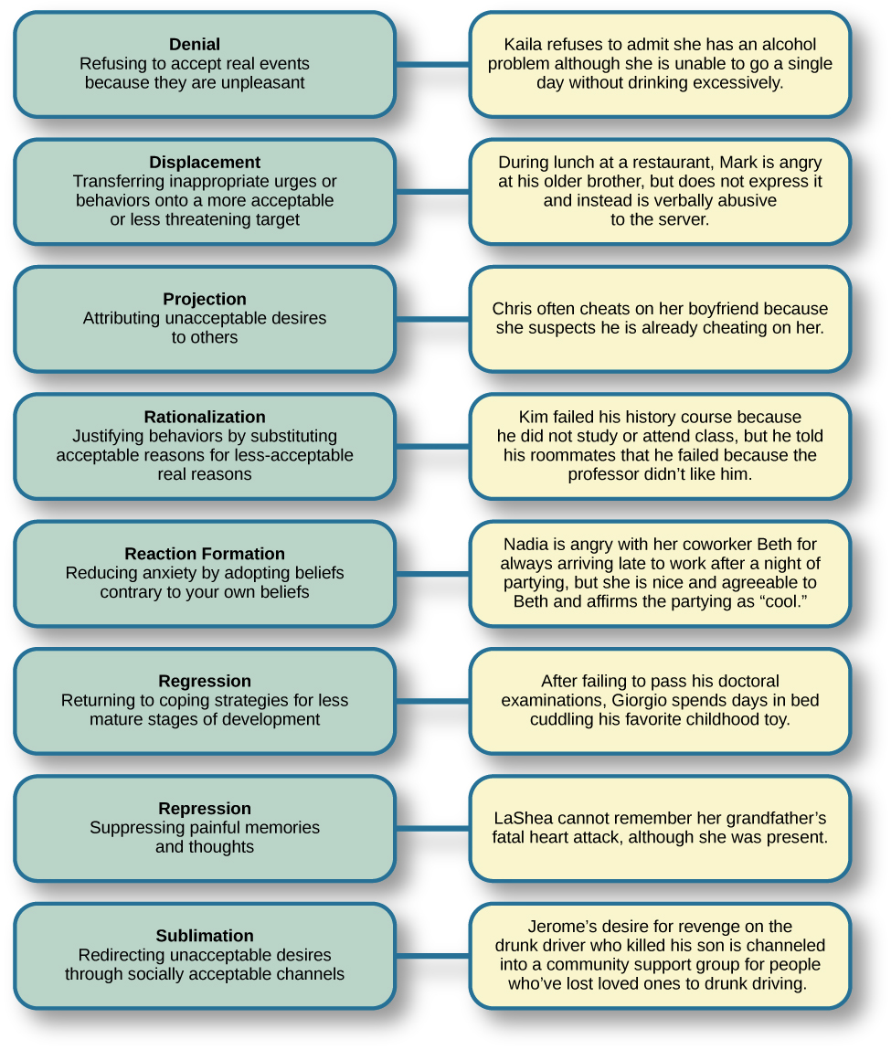

Slide 13
Stages of Psychosexual Development
Childhood experiences shape personality
Lack of proper nurturing and parenting leads individuals to become fixated
Pleasure-seeking urges focused on different areas of the body
Political, Social, and cultural influences in Freud’s day
Suppression of unconscious sexual and aggressive urges lead to neuroses

Slide 14
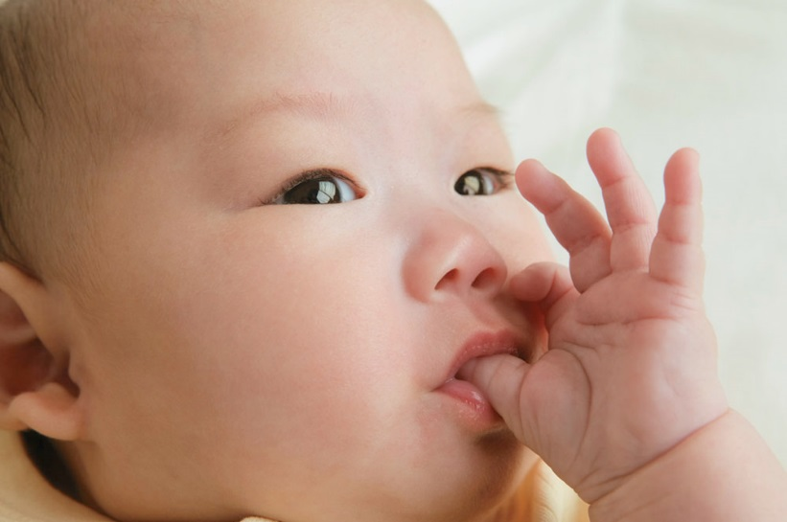
Freud’s Psychosexual Stages_x000b_in Personality Development
Oral Stage
  Birth to age 1
Anal Stage
  Ages 1 to 3
Phallic Stage
  Ages 3-6
  Boys: Oedipal complex
  Girls: Electra complex
Latency Period
  Age 6-12
Genital Stage
  12+

Slide 15
Oral Stage
Birth to 1 year
Pleasure focused on the mouth
  pleasure derived from sucking (nipples, pacifiers, thumbs)
Oral fixations (smoking, drinking, overeating, biting nails)
  seek to ease anxiety

Slide 16
Anal Stage
Ages 1 – 3
Pleasure in bowel and bladder movements
  Toilet training
Anal-retentive – stingy and stubborn (perfectionist)
Anal-expulsive – messy, careless, prone to emotional outburst

Slide 17
Phallic Stage
Ages 3-6
Erogenous zone is genitals
Boys – Oedipus complex (vain, ambitious)
  resolved when boy identifies with father
Girls – Electra complex (Jung not Freud)
  “penis envy”

Slide 18
Latency Period
6 years to puberty
Sexual feelings are dormant
Focus on school, friendships, hobbies, sports
Gender-roles

Slide 19
Genital Stage
From puberty on
Sexual reawakening
Socially acceptable partners
  often resemble opposite-sex parent
Well-balanced, healthy adult if reach this stage with no fixations

Slide 20
Stage/Period | Age | E. Zone | Conflict | Fixation
Oral | 0-1 | Mouth | Weaning | Smoking, overeating
Anal | 1-3 | Anus | Toilet Training | Neatness/Messiness
Phallic | 3-6 | Genitals | Oedipus/Electra | Vanity/Overambition
Latency | 6-12 | None | None | None
Genital | 12+ | Genitals | None | None

Slide 21
Neo-Freudians
Alfred Adler
Erik Erikson
Carl Jung
Karen Horney
Childhood experiences matter
Focused more on social environment and effects of culture

Slide 22
Alfred Adler
Individual Psychology
  Drive to compensate for feelings of inferiority
Inferiority Complex
  do not measure up to standards of others or society
Strive to gain superiority
  force behind thoughts emotions and behavior

Slide 23
Adler’s Social Tasks
Social development
Occupational Tasks
Societal Tasks
  friendship
Love Tasks
  intimate partner for long-term relationship
Conscious rather than unconscious
Birth order

Slide 24
Erik Erikson
Psychosocial Theory of Development
Personality develops throughout lifespan
Emphasized social relationships at each stage
8 stages (conflict or development task)
Successful completion = healthy personality

Slide 25
Stage | Age | Task | Description
1 | 0-1 | Trust vs. mistrust | Trust (or mistrust) that basic needs will be met
2 | 1-3 | Autonomy vs. shame/doubt | Sense of independence in many tasks develop
3 | 3-6 | initiative vs. guilt | Take initiative on some activities, may develop guilt when success not met
4 | 7-11 | industry vs. inferiority | Develop self-confidence in abilities when competent (inferiority if not)
5 | 12-18 | identity vs. confusion | Experiment with and develop identity and roles
6 | 19-29 | intimacy vs. isolation | Establish intimacy and relationships with others
7 | 30-64 | Generativity vs. stagnation | Contribute to society and be part of a family
8 | 65+ | Integrity vs. despair | Assess and make sense of life and meaning of contributions

Slide 26
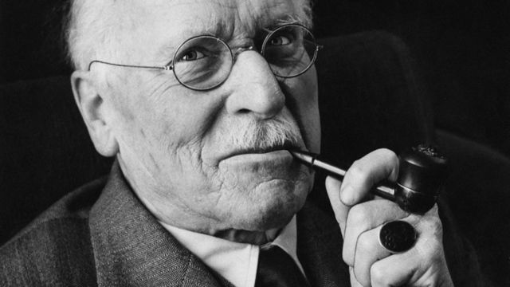
Carl Jung’s Analytical Psychology
Emphasized a more general life force
  Focused toward creativity, growth-oriented conflict resolution, and productive adjustment of basic impulses in light of real-world demands
Introversion vs. extroversion
Collective unconscious
Archetypes
Persona

Slide 27
Introvert | Extrovert
Energized by being alone | Energized by being with others
Avoids attention | Seeks attention
Speaks slowly and softly | Speaks quickly and loudly
Thinks before speaking | Thinks out loud
Stays on topic | Jumps from topic to topic
Prefers written communication | Prefers verbal communication
Pays attention easily | Distractible
Cautious | Acts first, thinks later

Slide 28
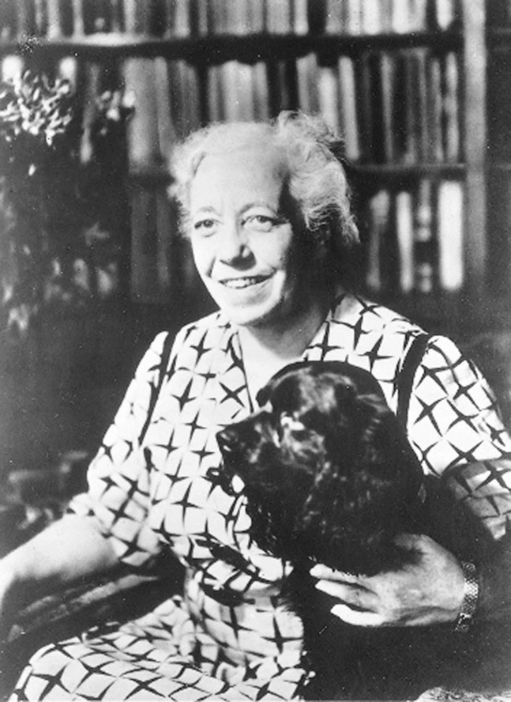
Karen Horney
Cultural factors, not instincts, play a major role in personality development
Men suffer womb envy
Women suffer from personal and political restrictions that men have placed on them
Three coping styles
  unconscious anxiety

Slide 29
Horney’s Coping Styles
Coping Style | Description | Example
Moving toward people | Affiliation and dependence | Child seeking positive attention and affection from parent; adult needing love
Moving against people | Aggression and manipulation | Child fighting or bullying other children; adult who is abrasive and verbally hurtful, exploits others
Moving away from people | Detachment and isolation | Child withdrawn from the world and isolated; adult loner

Slide 30
Evaluating the Psychodynamic Approach: Freud’s Contributions
Comprehensive and influential theory
Development of psychodynamic therapies
Led to personality assessment techniques
Some ideas supported by cognitive research

Slide 31
Evaluating the Psychodynamic Approach: Weaknesses
Based almost entirely on case studies
Western cultural bias
Possibly distorted by Freud’s personal biases
Questionable focus on male psychosexual development
Not very scientific

Slide 32


Learning Approaches
The Behavioral Perspective
Personality is shaped by the reinforcements and consequences in the environment.
Environment determines our enduring, consistent behavior patterns.
See personality as more variable over our entire life.

Slide 33
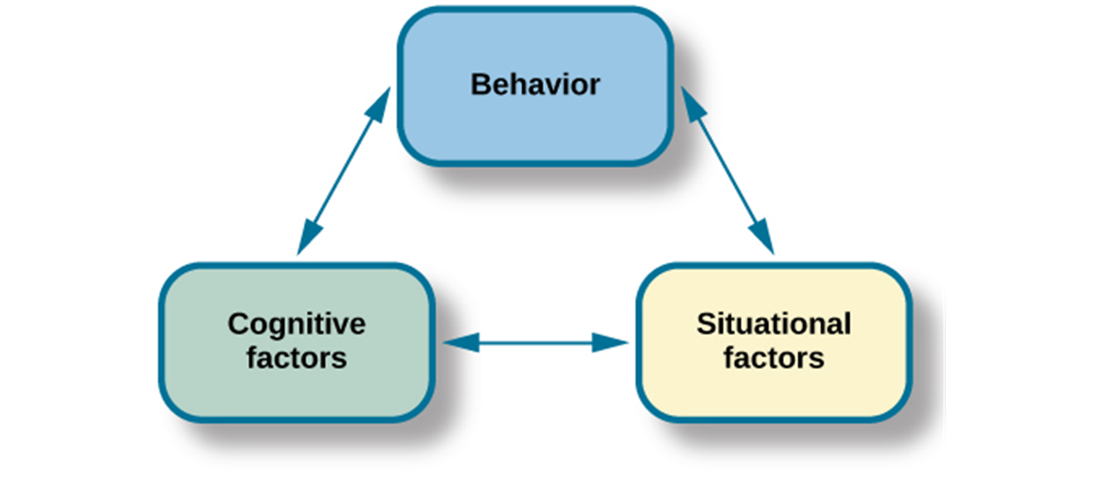
Learning Approaches
The Social-Cognitive Perspective
Albert Bandura
Reciprocal determinism: cognitive processes, behavior, and context all interact with each other.
Self-efficacy: level of confidence in our abilities, developed through social experiences.

Slide 34
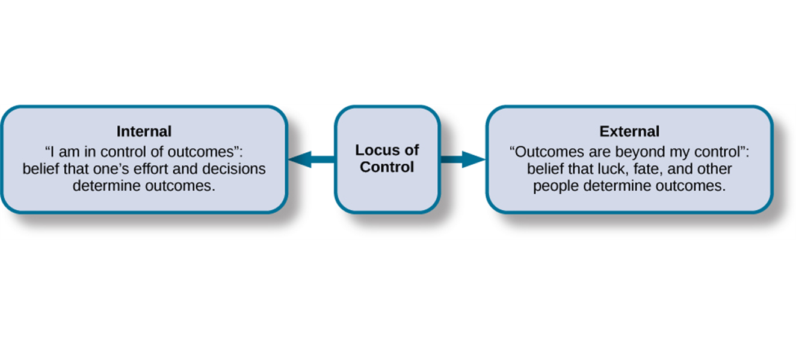
Learning Approaches
Rotter and Locus of Control
Behavior is guided by learned expectancies
Engaging in a behavior is determined by:
  Expectations of a behavior’s outcome
  Value placed on that outcome
Control orientation
  Internals expect to control events
  Externals expect to be controlled by outside forces

Slide 35

Learning Approaches
Mischel and the Person-Situation Debate
Walter Mischel: Social/Affective Theory
Behavior was inconsistent across different situations, but was much more consistent within situations.
The concept of self-regulation (will power)
The marshmallow study

